Slide 1
AI Project – decision tree Shaji Joseph CSCI 513: Python Programming for AI CWID: 50394653

Slide 2
Contents
Process Flow
Program Execution Flow
Limitations and Improvements
References

Slide 3
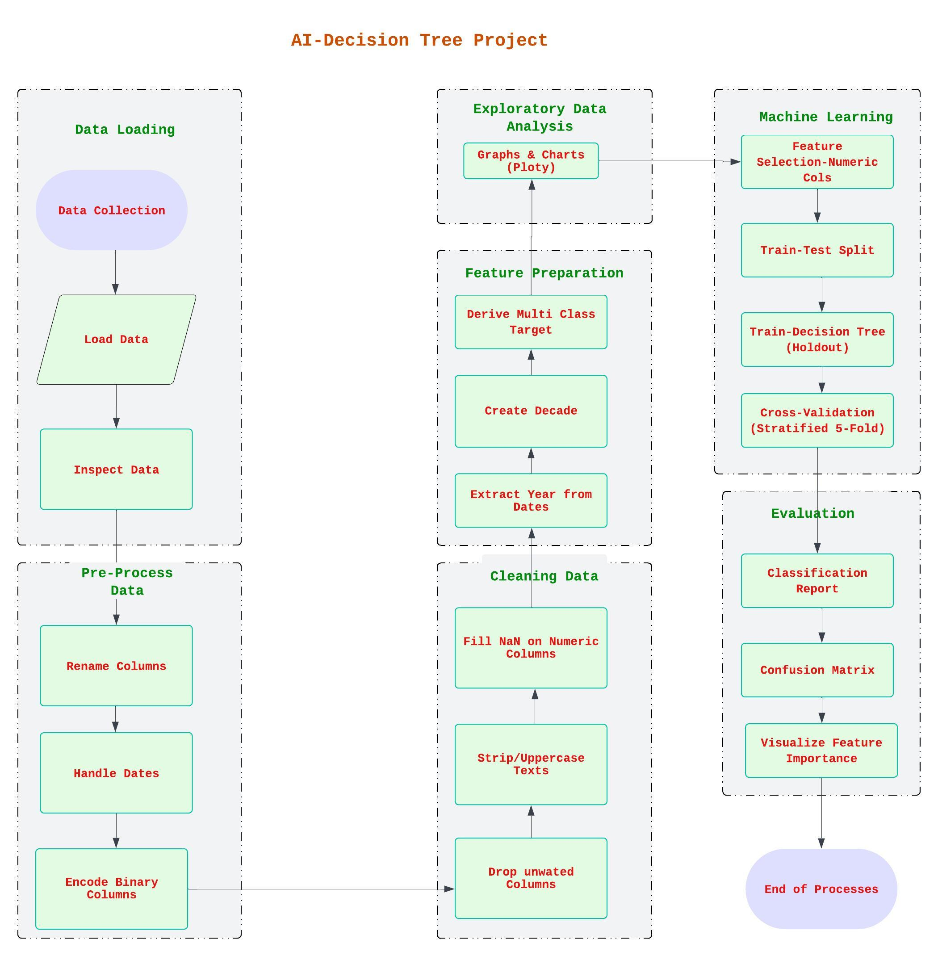

Process Flow
The Process flow above can be summarized as User Input → Data Collection →Load Data→ Pre-process Data →Data Cleaning → Visulization → Machine Learning → Evaluation

Slide 4

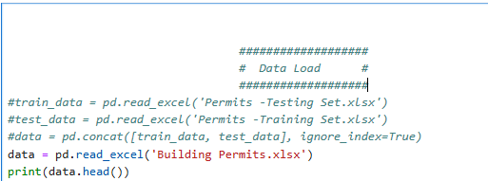
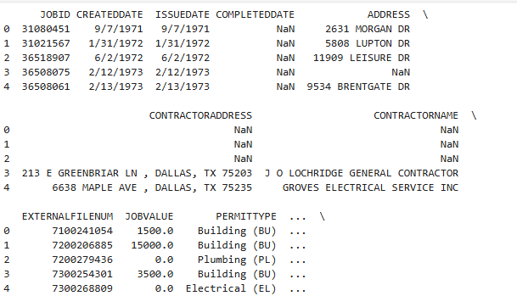
Data Collection and Loading
Data collected is from City of Dallas Building Permit System
The permits system has approximately 2 million permit records
The current Database for permits has records since 1970s
Extracted approximately 120 K records for this project distributed equally for each year until 2024.
Loaded Data into Pandas Data Frame and verified the data on the data frame “data”
Code for Data Load
Output

Slide 5
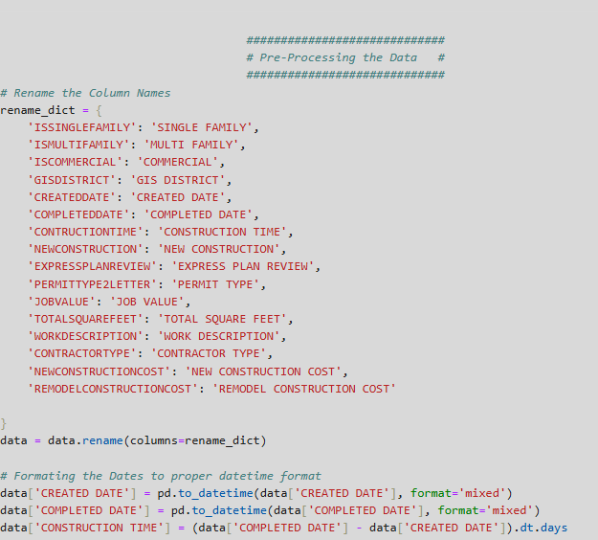
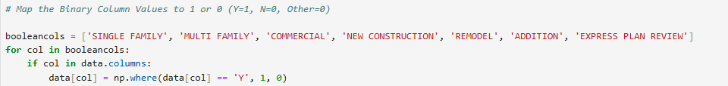
Pre-Processing the Data
Rename the Feature column names for better readability.
Date cols are formatted to Panda’s datetime objects to facilitate date/time-based filtering and date arithmetic
Calculate the CONSTRUCTION TIME = COMPLETED DATE – CREATED DATE. CONSTRUCTION TIME is the time taken in days to complete a building project. Added a new col CONSTRUCTION TIME .
Map the Boolean target values to 1 or 0
Map Y/Yes/True ->1
Map N/No/Other/Nan->0
Rename the Feature Cols
Format the date cols to datetime
Code for Mapping Binary Cols

Slide 6
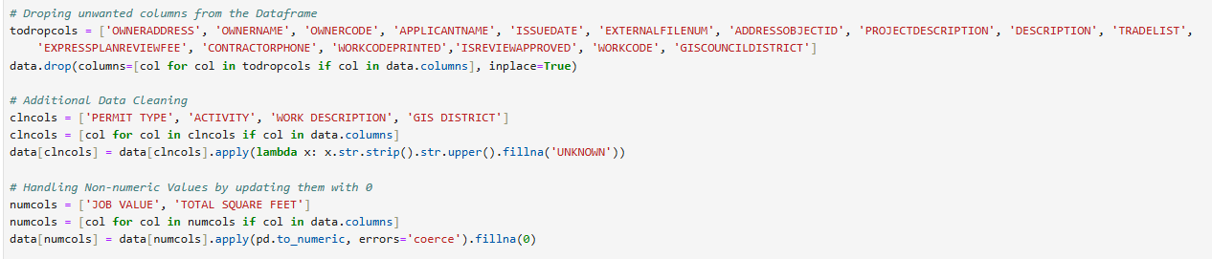
Data Cleaning
Drop unwanted columns, which are Irrelevant, or redundant, or High-cardinality from the data frame .
Striping whitespaces, converting to Uppercases, and replaces missing values with UNKNOWN
Converts non-numeric values NaN and silently converts invalid values to NaN.
Replaces NaN with 0
Code for Data Cleaning

Slide 7
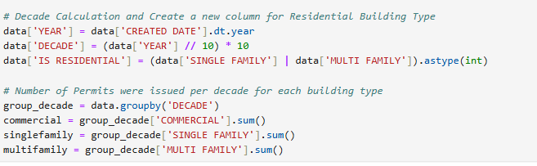
Feature Preparation
Extract YEAR from CREATED DATE and added a new column for this.
Calculate the DECADES from YEAR and added a new column for it.
Segregate Residential buildings from Commercial Buildings
Aggregating building permits by decade and sum it up for each building type.
Feature Preparation

Slide 8

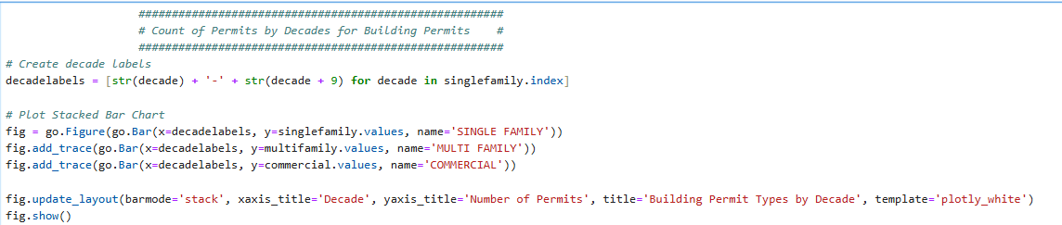
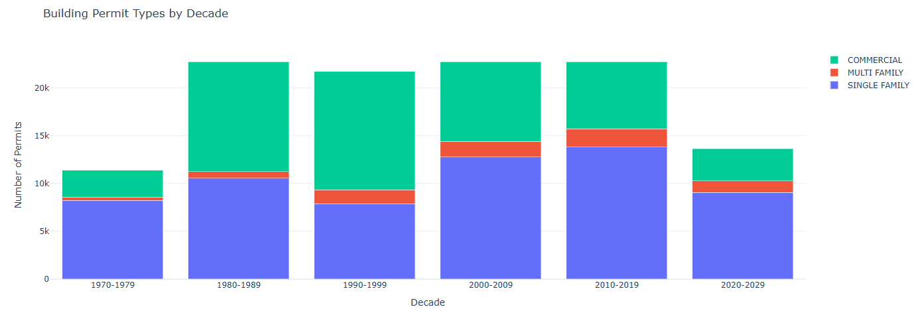
Exploratory Data Analysis
Decade labels are created in the format of 2000 - 2009
Build the Stacked Bar Chart for Permits by Decade for each Permit Type.
Formatting the layout for better readability.
Code for Building Permits by Decade
Output

Slide 9
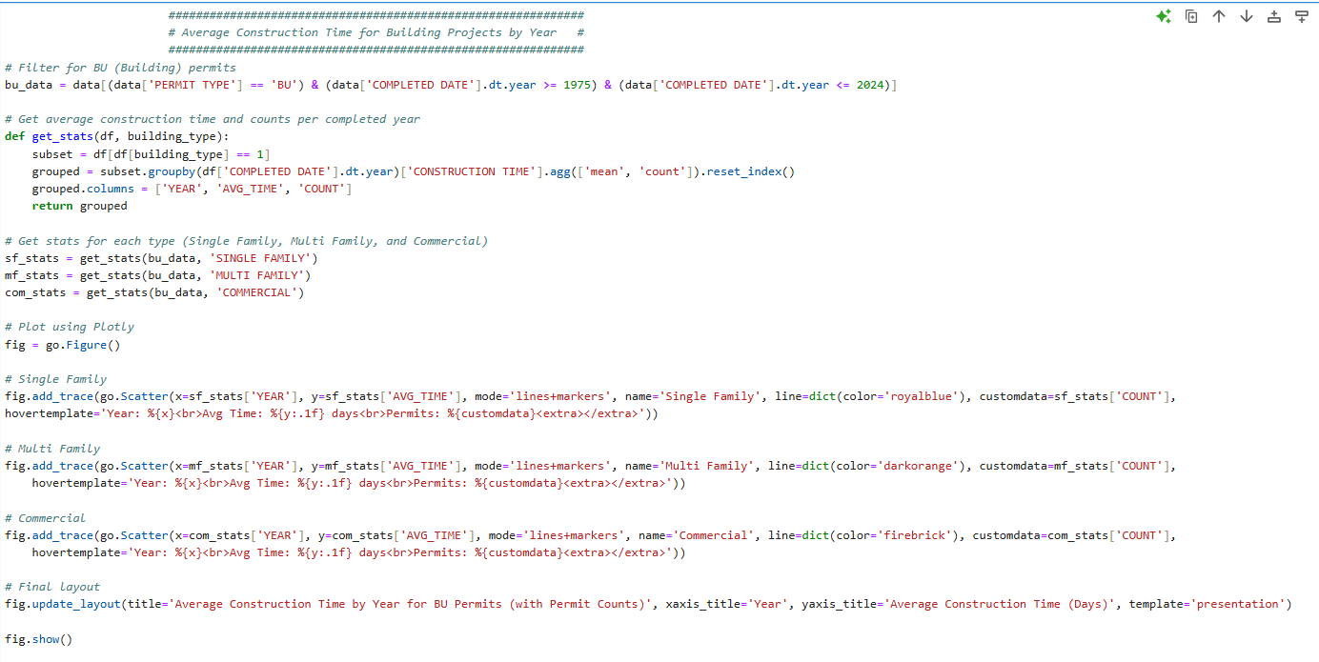
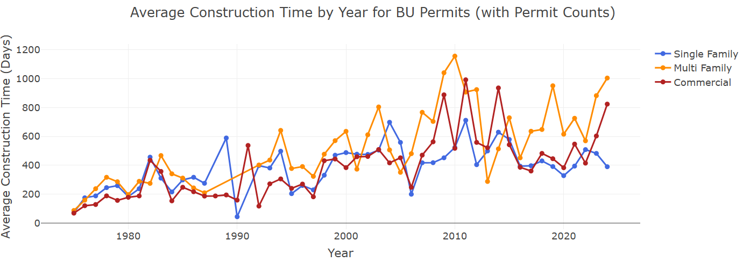
Exploratory Data Analysis
Filter the data based on Year. That means data between years 1975 and 2024.
Filters data for each building type and averaging and aggregating.
Create the line chart using Ploty
Output
Code for Average Construction Time by Year

Slide 10
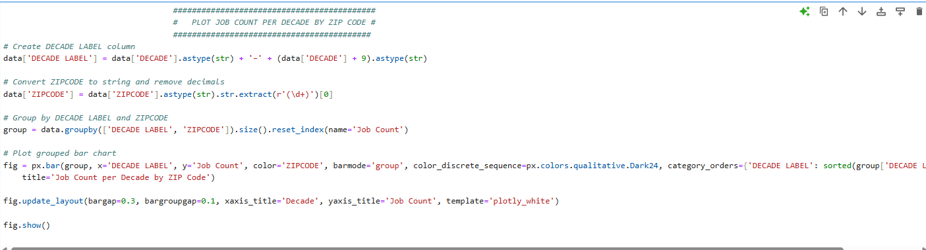
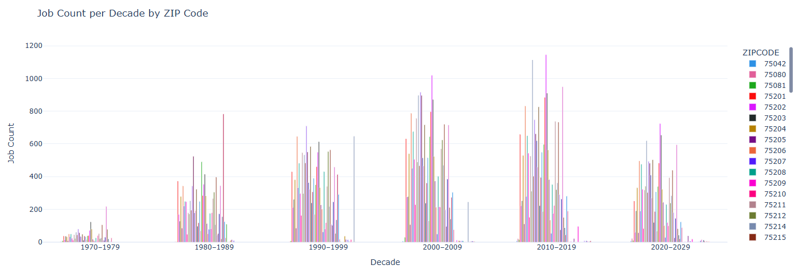
Exploratory Data Analysis
Create Decade labels and clean zip codes by extracting only digits.
Group Data by Decade and Zip Code.
Create the Grouped Bar Chart using Ploty.
Job Count per Decade by ZIPCODE
Output

Slide 11
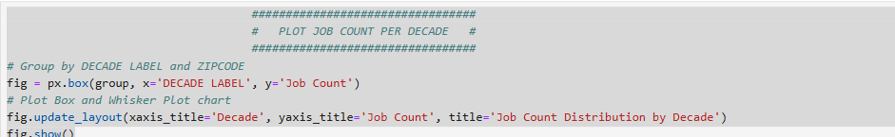
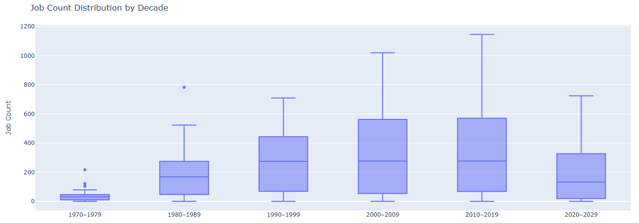
Exploratory Data Analysis
Create Decade labels, Clean the Zip Codes, and group the data by Decade and Zip Code.
Create box plots using Ploty for the grouped data and layout formatting for readability.
Code for Job Count distribution per Decade
Output

Slide 12
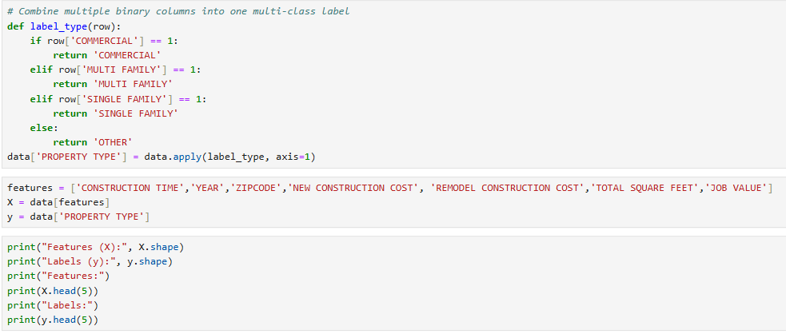
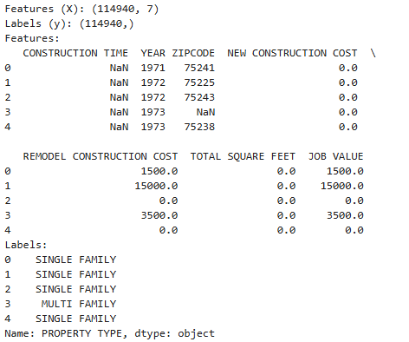
Machine Learning
Combines the binary columns, COMMERCIAL, MULTI FAMILY, and SINGLE FAMILY into one categorical col.
A new column PROPERTY TYPE is created for this.
Define Features, and Target. Verify the Data with the shape of Feature Matrix.
Code for multi class label column, Define Features, and Targets
Code for Data Verification
Output

Slide 13
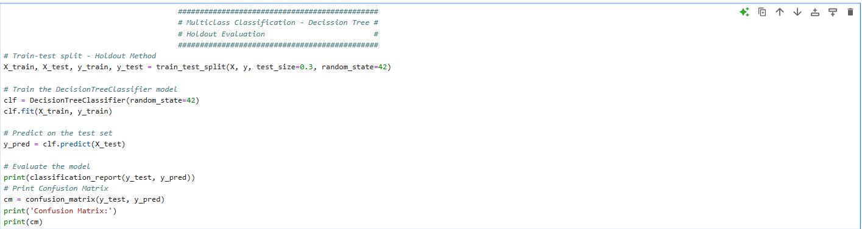
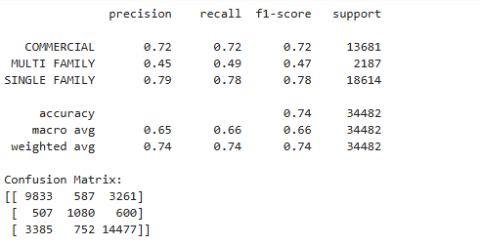
Machine Learning
Splits Data into Training Set(70%) and Testing Set(30%). Random State = 42 enables reproducibility.
Decision Tree Model Training. Generates Prediction(y_pred).
Model Evaluation. Generates output for each class(Commercial, Multi Family, Single Family) and Confusion Matrix
Code for Train-Test Split (Holdout), Decision Tree Model, Prediction, and Model Evaluation
Output

Slide 14
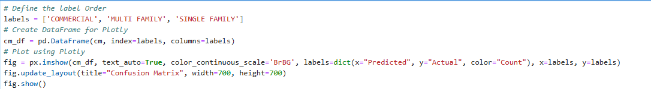
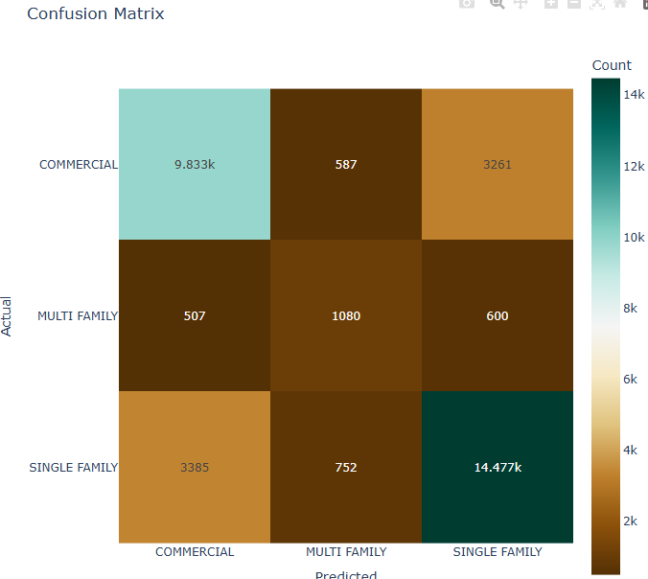
Machine Learning
Define labels and convert Confusion Matrix to Data Frame.
Create Heat Map for Confusion Matrix.
Customize the Layout for better readability.
Code for Confusion Matrix Visualization
Output

Slide 15
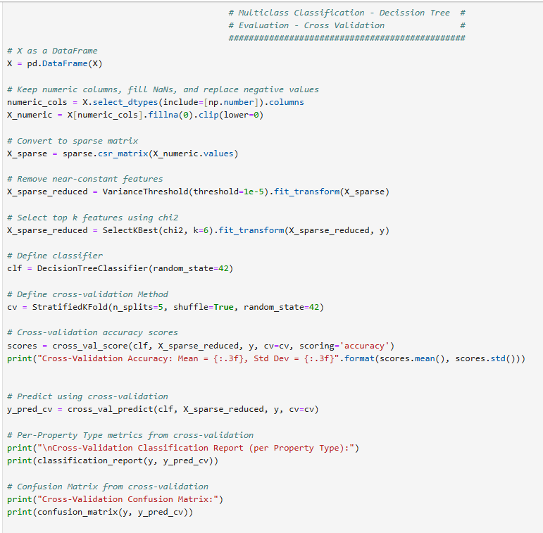
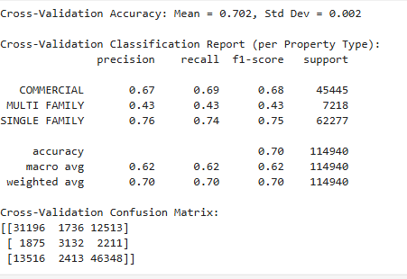
Machine Learning
Feature Pre-Processing and ensures all features are numeric.
Sparse Matrix Conversion and Feature Selection. Remove near constant Feature and select top features using chi -Square
Cross Validation Setup. Data Split into 5 splits. Model Evaluation, Classification Report, and Confusion Matrix
Code for Cross Validation Evaluation
Output

Slide 16
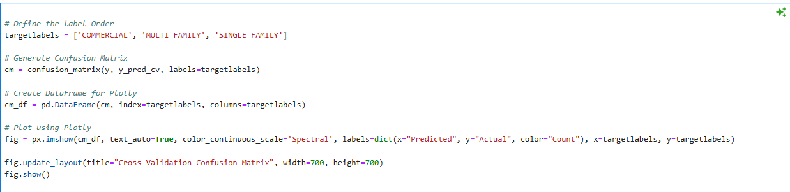
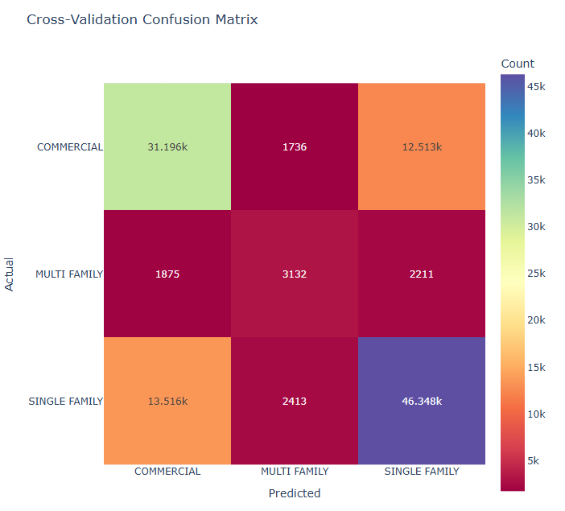
Machine Learning
Create Heatmap and customize the Layout
Output
Code for Confusion Matrix Visualization

Slide 17
Limitations and Improvements-Decision Tree (Holdout Method)
Decision Tree may not be the right choice for the data we have because of
The dataset contains noise
Imbalanced Target Variables
Irrelevant Features
Underfitting
The classification report and Confusion Matrix shows this model is biased towards SINGLE FAMILY class. It has the strongest performance ( F1 = 0.78)
SINGLE FAMILY is the most frequent class
Multi Family has the lowest F1 = 0.47 and it has low precision and recall.
COMMERCIAL Class has the medium performance
Confusion Matrix
Has COMMERCIAL ->3261 misclassified as SINGLE FAMILY
Has Multi Family -> Most confusion with SINGLE FAMILY (600) and COMMERCIAL(507)
Has SINGLE FAMILY ->Misclassified as COMMERCIAL(3385) and MULTI FAMILY(752)
This shows that the model struggles to distinguish similar or overlapping features, especially between SINGLE FAMILY and the other types
My data is imbalanced, and the Decision Tree is underperforming for the MULTI FAMILY Class

Slide 18
Limitations and Improvements-Decision Tree (Cross Validation)
MULTI FAMILY still remains the weakest
It works reasonably well with SINGLE FAMILY and COMMERCIAL
The scores are consistent with Holdout Results
Macro Average (F1=0.62) shows underperformance on minority classes.
Weighted Average (F1=0.70) looks better but heavily biased by SINGLE FAMILY
COMMERCIAL and SINGLE FAMILY are confused each other (12,513 and 13516 respectively)
MULTI FAMILY has significant Overlap with the other two classes.
The performance is weak for the same reasons as listed in Holdout Method.
Comparison and Conclusion
Metric | Holdout | Cross-Validation
Accuracy | 0.74 | 0.702
Macro F1-Score | 0.66 | 0.62
MULTI FAMILY F1 | 0.47 | 0.43
Holdout shows slightly better performance but may overfit
The poor performance for MULTI FAMILY warrant resampling, feature engineering or even a different classifier

Slide 19
References
Plotly. Plotly Python Graphing Library. (n.d.). https://plotly.com/python/
1.10. decision trees. scikit. (n.d.). https://scikit-learn.org/stable/modules/tree.html
Jurafsky, D., & Martin, J. H. (2000). Speech and Language processing: An introduction to natural language processing, computational linguistics, and speech recognition. In Prentice Hall eBooks. https://nats-www.informatik.uni-hamburg.de/pub/CDG/JurafskyMartin00Comments/JurafskyMartin00-Review.pdf
Python 3.13 documentation. (n.d.). Python Documentation. https://docs.python.org/

